Slide 1




AI Powered Doctor Appointment System
with Symptom-Based Routing
404 Not Found

Slide 2

Theme: Healthcare Technology
Hours in lines Minutes with Doctors
“Fixing Delays with Smart Tech”
Manual appointment chaos
Poor patient experience due to long wait times.
Operational inefficiencies and miscommunication.
Bottleneck in providing timely patient care.
Phone Calls,Paper logs creates Frustrating Delays
Patients in waiting Line creates pressure on Doctor Comprising Quality
Miscommunication between departments leads to wasted Slots ,no Shows Overwhelmed Staff
Not all wounds bleed, Some internal injuries could go critical While waiting

Slide 3
PROPOSED SOLUTION
All in One Digital Management Platform:-
Admin Panel: Centralized Hospital/clinic control
User Panel: Intuitive Patient Service
Key Innovations:
For Hospitals :
For Patients :
Manage Appointments
Service Load Analytics for Staff Optimization
Edit Clinic and Doctor Profile Dynamically
Seamless Appointment Making
Real Time Queue Tracking
Free from Cash counters lines

Slide 4
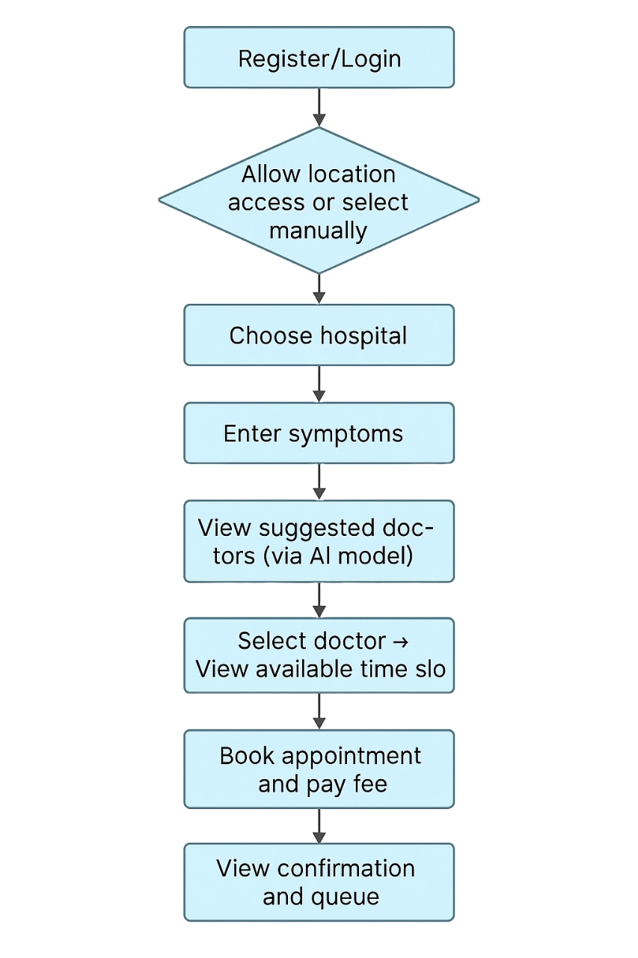

Slide 5
Explanation
Register/Login: The patient logs into the system using existing credentials or creates a new account.
Allow Location Access / Select Manually: The app asks for location permission to find nearby hospitals, or the patient can choose a location manually.
Choose Hospital: The patient selects a hospital from the available options based on their location.
Enter Symptoms: The patient inputs their symptoms into the system.
AI Model Suggests Doctor Type: Based on the entered symptoms, an AI model predicts and suggests the appropriate type of doctor (e.g., ENT, dermatologist).
Select Doctor & View Time Slots: The patient selects a doctor from the suggested list and views available time slots for appointments.
Book Appointment & Pay Fee: The patient finalizes the appointment and completes the payment process.
View Confirmation & Queue Status: A confirmation is shown along with the patient’s position in the live queue (if available).

Slide 6
FEATURES AND NOVELTY
The Future of Healthcare
AI-Powered Smart Triage Novelty: First system to prioritize appointments based on symptom severity (not just "first come, first served").
Uses NLP to analyze patient inputs (e.g., "chest pain" → flagged as urgent).
Real-Time Dynamic Scheduling
Novelty: Self-adjusting slots—auto-reschedules if a doctor runs late or a critical case arrives.
Reduces wait times by 40% (vs. static systems).

Slide 7
Drawbacks
If Hospitals Don’t Register : System FailsWhy? No adoption = no data for AI to learn or optimize schedules.
Patients keep calling clinics directly :chaos continues.Doctors ignore the system → double bookings return.
Showstopper
Dynamic Location Filtering:Eliminates confusion for users . . . . . unfamiliar with hospital locations.
AI-Powered Triage: Reduces misdiagnosis risk by guiding patients . to the right specialist.
Enterprise API: Licensing for integration with existing systems
Data Analytics: Premium insights for hospitals

Slide 8
404NotFound
Name Contact Details
Mahak 9053436972
Md. Gulfam 9534006577
Arghadeep Das 7872863675
Sagar Maheshwari 8955650560

Slide 9
Thank you

